Slide 1
Welcome to St.Thomas
Catholic Academies Trust
The glory of God is a human being fully alive!

Slide 2
Welcome to STCAT Hub
Working in partnership with
Regional hubs across the SouthEast
STCAT, Surrey, Sussex, London, Greater London, Berkshire
Notes:
Hub logos and explanation of regional hubs

Slide 3
Welcome
9.30 - 9.45 Arrival and coffee
9.45 - 10.30 Routes to QTS presentation
10.30 - 10.45 Q&A
Individuals are welcome to stay to ask their own questions

Slide 4
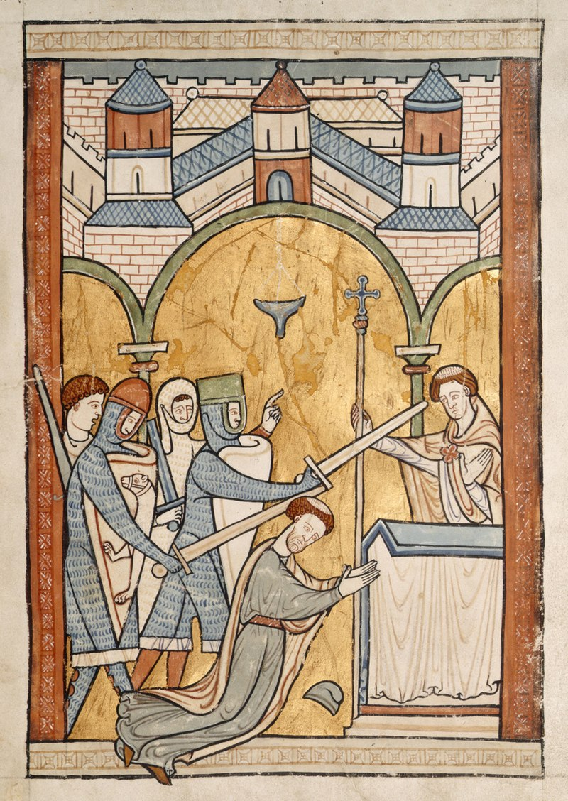
Let us pray
Dear Lord
We pray that the courage of St Thomas may inspire us to achieve together more than we can dream or imagine. We ask for your guidance, wisdom and support as we seek to nourish the bonds of community between our family of schools and those who seek to join them.
St Thomas - PRAY FOR US!

Slide 5
Why teach? Why with us?
The glory of God is a human being fully alive!
Best job in the world?
Profession whose purpose is to make people better at what they do
Helps young people tread paths towards achieving their dreams
The ‘business’ of long-term happiness
Primary teachers set pupils on their first steps along these paths
Each of our schools has its own feel but a common mission runs through each – love of the children, Gospel values, inclusivity.

Slide 6
Background to Xavier Teach SouthEast (Chertsey/Woking based)
A growing partnership of primary and secondary schools
Regional hubs in Surrey, Sussex, Berkshire and London
Offering a range of subjects for secondary Initial Teacher Training (ITT), primary ITT and other routes into teaching
“Outstanding in all categories”, Ofsted inspection 2018 and 2023

Slide 7
Trained over 1400 ITT trainees since 2013:
The majority remain in partnership schools
Many are in leadership positions
Every year, 100% of our cohort gain QTS
We have an exclusive partnership with Eteach, offering employment support and advice for all trainees

Slide 8
A large partnership, with the personal touch
Throughout your year you will be supported in the following ways to ensure that you reach your potential:
Pastoral coaches,
In-school Mentors,
Subject Tutors,
SCITT Leads/In-school support,
Teach SouthEast Team,
Peer Trainees

Slide 9
What is it like to be a trainee at this ITE provider?
“Trainees’ progression through the curriculum is led and overseen by highly skilled expert trainers and mentors. Communication throughout the partnership is excellent. Trainees know that their views are valued and will contribute to improvement. Trainees receive practical and sensitive support for their workload and well-being. Typical of the views of many, one trainee commented that “you can feel comfortable, honest and safe when asking for help and guidance.”
Ofsted Feb 2023
"STCAT’s support and emphasis on professional growth have made a real difference in my development as a teacher. The focused subject training, regular feedback, and a close-knit cohort has helped me grow in confidence and develop practical skills for the classroom.”
2024-5 Trainee

Slide 10
Two main routes to QTS
SCITT – School Centred Initial Teacher Training – 1 year
Assessment Only – for experienced colleagues with 2 years’ worth of timetabled teaching responsibilities eg. HLTAs, Unqualified teachers etc

Slide 11
Xavier Teach SouthEast: Our role in ITT
We recruit trainees in partnership with our regional hubs and recommend trainees at the end of the training year for Qualified Teacher Status (QTS)
We work with Sussex University to accredit the PGCE programme (you can opt to do QTS only)
Trainees train and work in our partner schools
Routes into ITT with us:
Fee-paying with PGCE
Fee-paying QTS only

Slide 12
Structure of your SCITT training year
Both fee-paying routes qualify with QTS
Based at your ‘home school’ with a dedicated mentor for two terms (autumn and summer)
One half term ‘away’ placement at a partner school in the spring term
Weekly training on pedagogy and subjects
Additional 12 days ITAP (Intensive Training and Practice in 4 skill areas throughout the year
‘Enhancement days’ include:
Secondary school
Special (SEND) school
LSA shadowing
And may include:
Pupil referral unit (PRU)

Slide 13
How do the two training routes differ?
Fee-paying​
Qualify with QTS and PGCE​
Tuition fees of £9,535​​
Fee-paying​
Qualify with QTS only
Tuition fees of £8,196

Slide 14
For both Primary routes you need:
GCSEs at Grade 4/C (or equivalent) or above in:
English
Maths
Science
Honours degree (2:2 or above)
Right to work in UK (no Visa sponsorship is available for this course)
Identification eg. passport, driving licence, proof of address
’Clean’ DBS checks

Slide 15
PGCE
Accredited by The University of Sussex
Applying Professional Knowledge (APK) – coursework essay evaluating the impact of a chosen area of pedagogy on professional practice (6000 words)
Reflecting on Professional Knowledge (RPK) – an informal interview, mapping your progression in ‘The Teachers’ Standards,’ including reference to relevant research
Tutorials with your university tutor
Full access to the library, including electronic and virtual resources

Slide 16
Assessment for QTS
One weekly Mentor meeting with school Mentor​
One formal observation and feedback each week by the Mentor​
Assessed during the year (end of each term but with an additional Autumn Mid-term review) against the nine areas of our curriculum, (which includes things like: how you create a positive classroom culture, how you adapt your teaching for the needs of the pupils and how you have taken on the role of the teacher as a professional)
‘Professional conversations’ throughout the year to discuss your training, reading and classroom practice and how you are developing this

Slide 17
Looking beyond your training year: leadership pathways
A partnership that nurtures leadership talent:
Developing outstanding teachers throughout career
Identifying and developing leaders of tomorrow
Beyond your training year:
STCAT is a delivery partner for Xavier Teaching School Hub’s 2-year Early Career Framework programme (ECF) with the TeachFirst Curriculum.
Continual Professional Development
As a partnership of schools, we hold the National License for the following programmes:
NPQLT: Leading Teaching
NPQLTD: Leading Teacher Development
NPQLBC: Leading Behaviour and Culture
NPQLL: Leading Literacy
NPQEYL: Early Years Leadership
NPQSL: Senior Leaders
NPQH: Headship
NPQEL: Executive Leadership

Slide 18
How do I apply?
www.stcat.co.uk /becoming a teacher / Fast track
www.teachsoutheast.co.uk or
https://www.gov.uk/apply-for-teacher-training – search for STCAT or Teach South East

Slide 19
Your interview day
Interview day at one of our STCAT schools:
Plan a 25 min lesson on a given topic – deliver lesson to interview panel
Panel interview, including a resilience scenario
Live Literacy task
Collection of identification and qualification documentation

Slide 20
Am I eligible for the salaried/apprentice route?
This route is available but very limited for primary teaching
It is:
competitive
subject to school availability
suitable for a candidate already working in or who has an existing relationship with an STCAT school or who has significant relevant teaching experience e.g. HLTAs, Unqualified teachers
Expectations:
Full ownership of class(es) including report writing, parents’ evenings
Higher percentage timetable
Less feedback

Slide 21
How do you decide placement schools?
Discussed at interview
Preferences considered
Mentor/department/year/school quality, capacity, availability and suitability
Commuting distance
Personal circumstance

Slide 22
Assessment Only Route (AO)
12 week programme leading to QTS
Requirements:
Hold a degree
GCSE Maths, Science and English at Grade C or 4 or higher
Extensive prior teaching experience (2 or more years)
Be meeting the Teachers’ Standards without further training
Have the support of your current school
Have access to 2 consecutive phases in primary
*please refer to flyer

Slide 23
Any questions?
Find out more:
www.stcat.co.uk
Office: 01582 361600 Mobile: 07977 140649
anicol@stcat.co.uk
ccooper@stcat.co.uk
j.crome@xaviercet.org.uk
@teachsoutheast
Teach SouthEast
@teachsoutheast
@teachsoutheast

