Slide 1
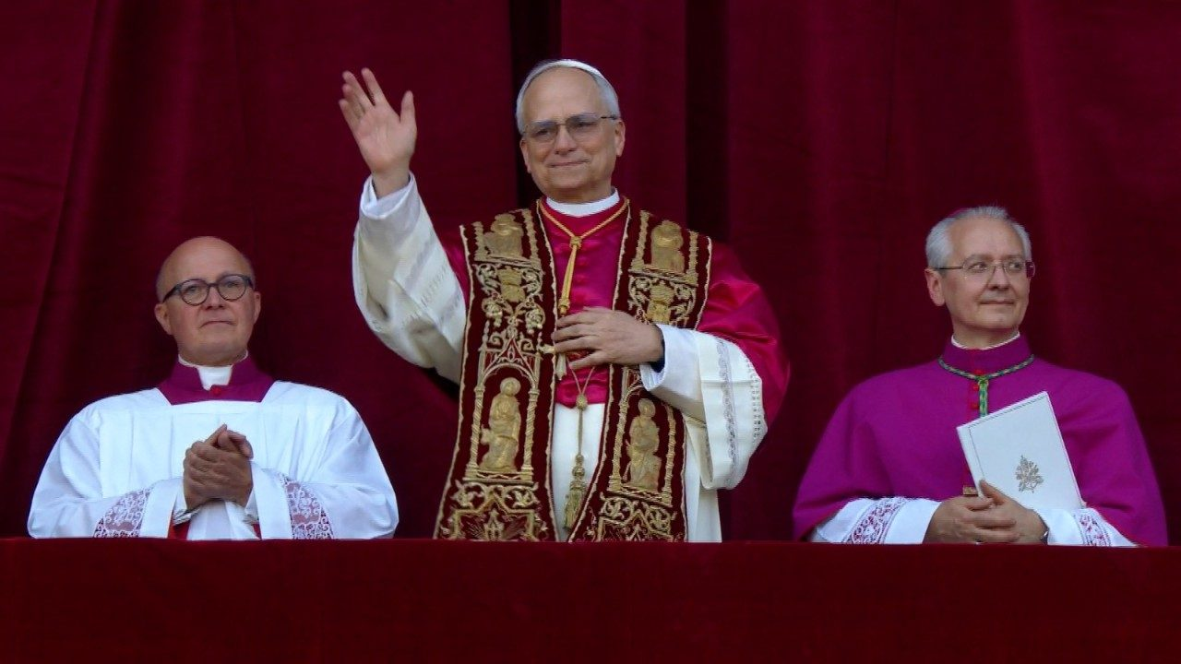
Pope Leo XIV

Slide 2
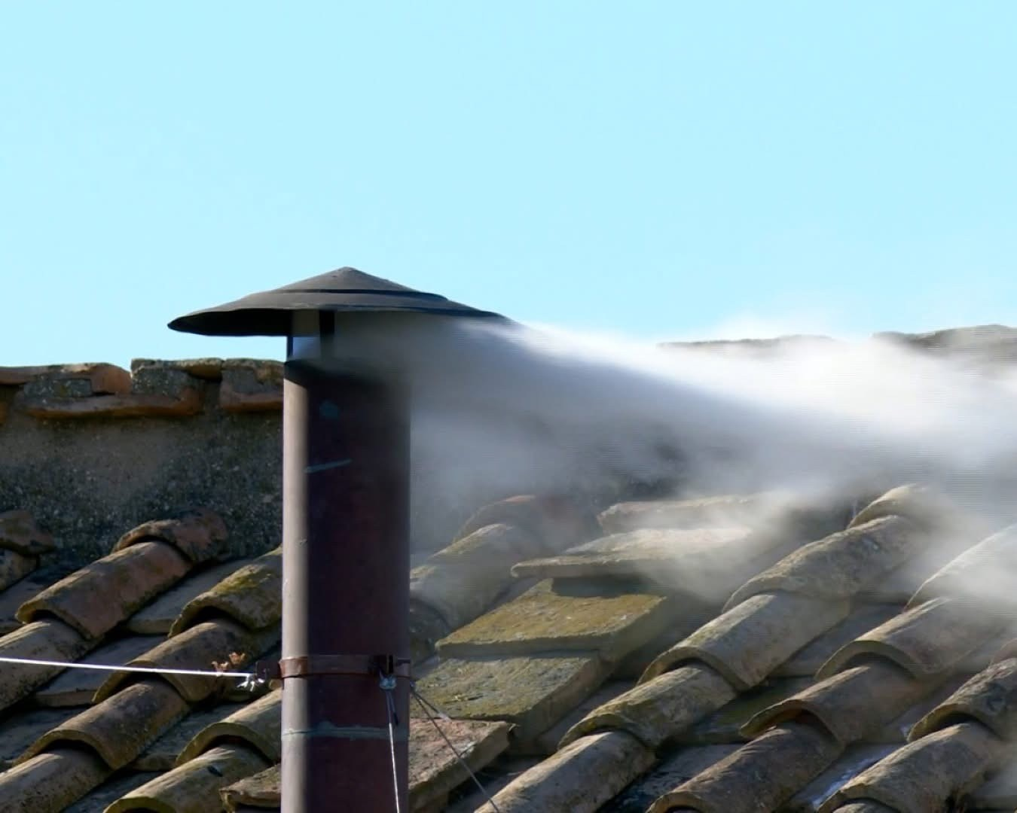
On Thursday 8th May, after just two days of voting in the conclave, white smoke appeared from the chimney above the Sistine Chapel and the bells were rung, signalling to the thousands of people gathered in the square below that a new pope had been elected.
Thousands more people rushed to the square to await the announcement.

Slide 3
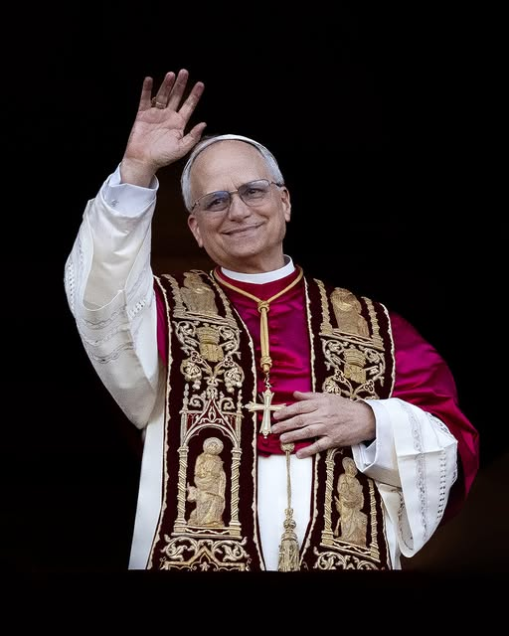
Just before 6.20pm, it was announced that Cardinal Robert Prevost had been elected as the 266th Successor of Saint Peter and that he would be taking the name ‘Pope Leo XIV’.
He is the first pope from North America and the first pope who is a member of the Augustinian religious order.

Slide 4
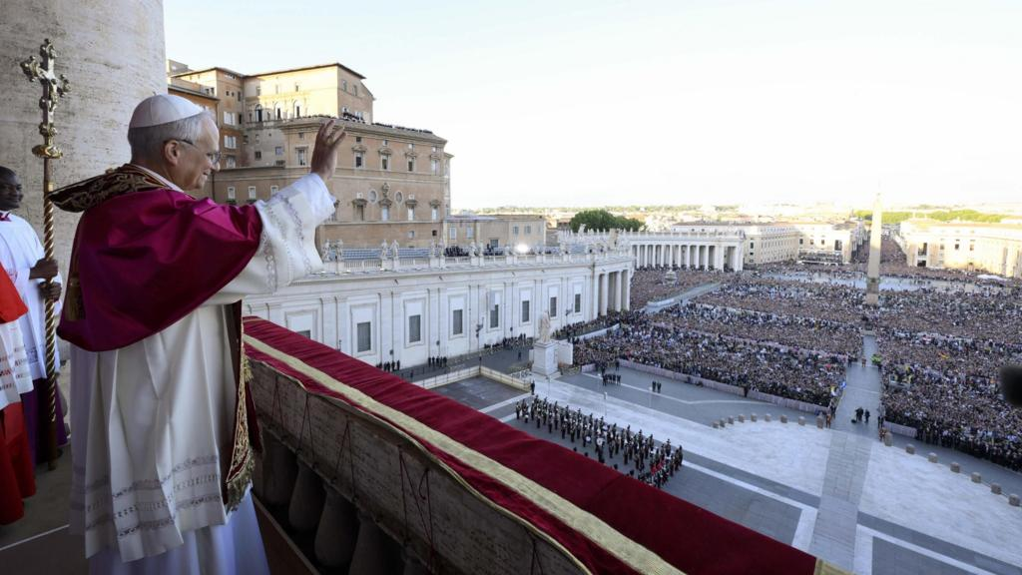
The sight that greeted the new pope – thousands of people in St Peter’s Square – must have been both slightly daunting and also encouraging.
He knows that he has great support, not only from people there, but from Catholics all around the world.

Slide 5
He has chosen the name Leo. The last pope with this name was Pope Leo XIII, over one hundred years ago, whose work was the basis for Catholic Social Teaching.
As we celebrate this Year of Jubilee when we are called to be Pilgrims of Hope, we give thanks that Pope Leo will continue to speak up for those who are poor or marginalised in our world.
In his first speech, Pope Leo said, ‘We are disciples of Christ, Christ goes before us, and the world needs his light. Humanity needs Christ as a bridge to be reached by God and his love. Help us, and help each other, build bridges.’

Slide 6
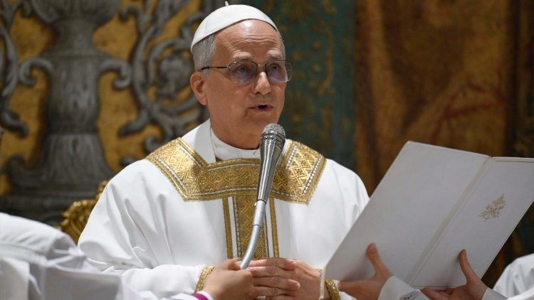
Pope Leo speaks many languages – English, Spanish, Italian, French and Portuguese – and he can also read Latin and German.
He was born in Chicago but has spent many years living in Peru as a missionary. He has been a cardinal for less than two years.

Slide 7
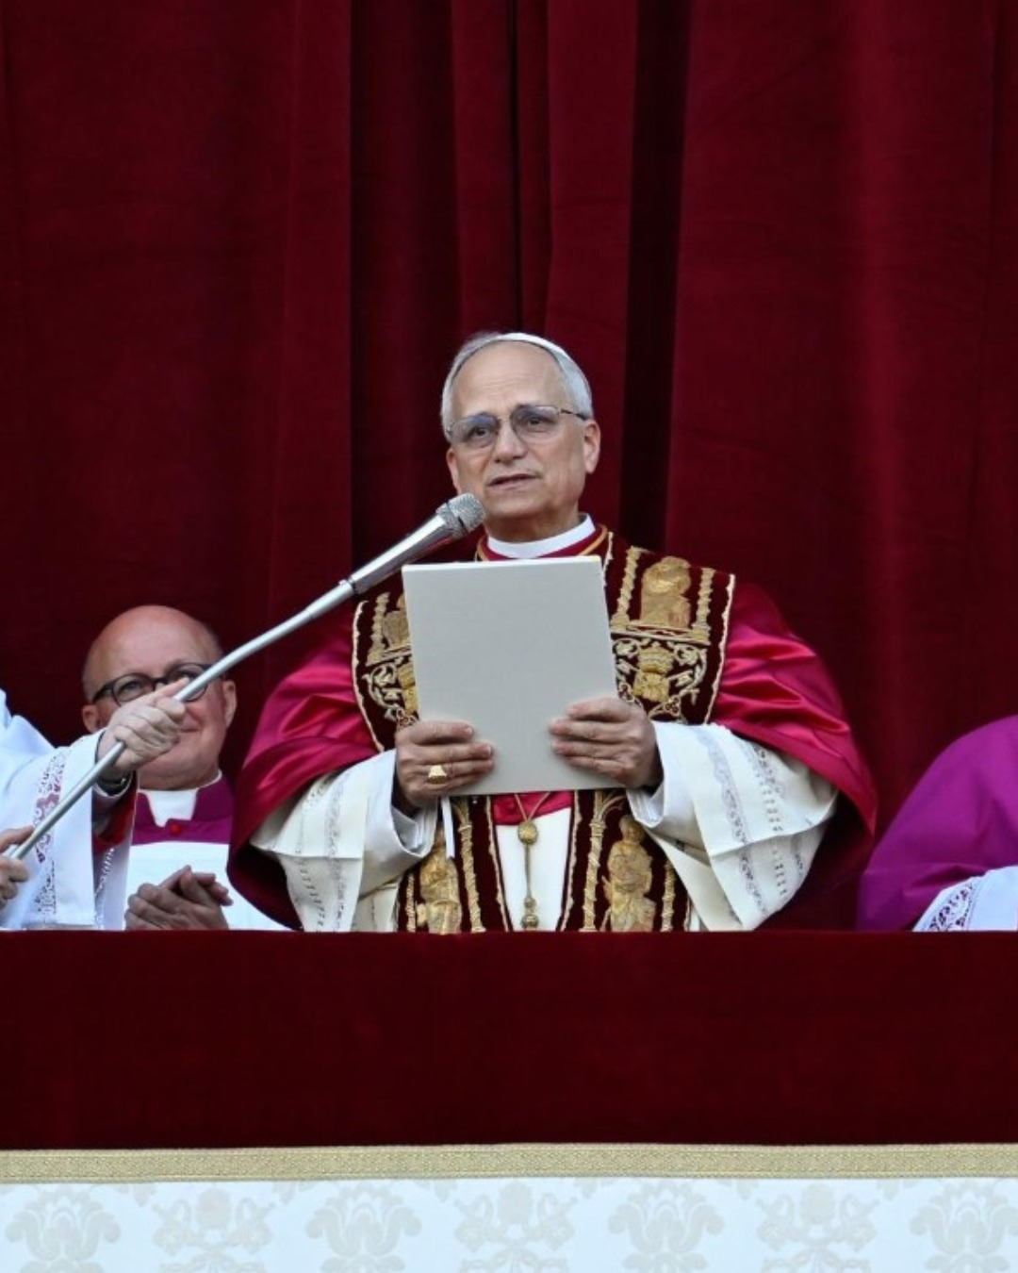
On the balcony, Pope Leo’s first words were ‘Peace be with all of you’, echoing the words Jesus spoke to his disciples when he appeared to them after his Resurrection.
Let us listen to those words from John’s Gospel.

Slide 8
On the evening of that day, the first day of the week,
the doors being locked where the disciples were for fear of the Jews,
Jesus came and stood among them and said to them,
‘Peace be with you.’
When he had said this, he showed them his hands and his side.
Then the disciples were glad when they saw the Lord.
Jesus said to them again, ‘Peace be with you.
As the Father has sent me, even so I am sending you.’
And when he had said this, he breathed on them
and said to them, ‘Receive the Holy Spirit’.
John 20:19-22

Slide 9
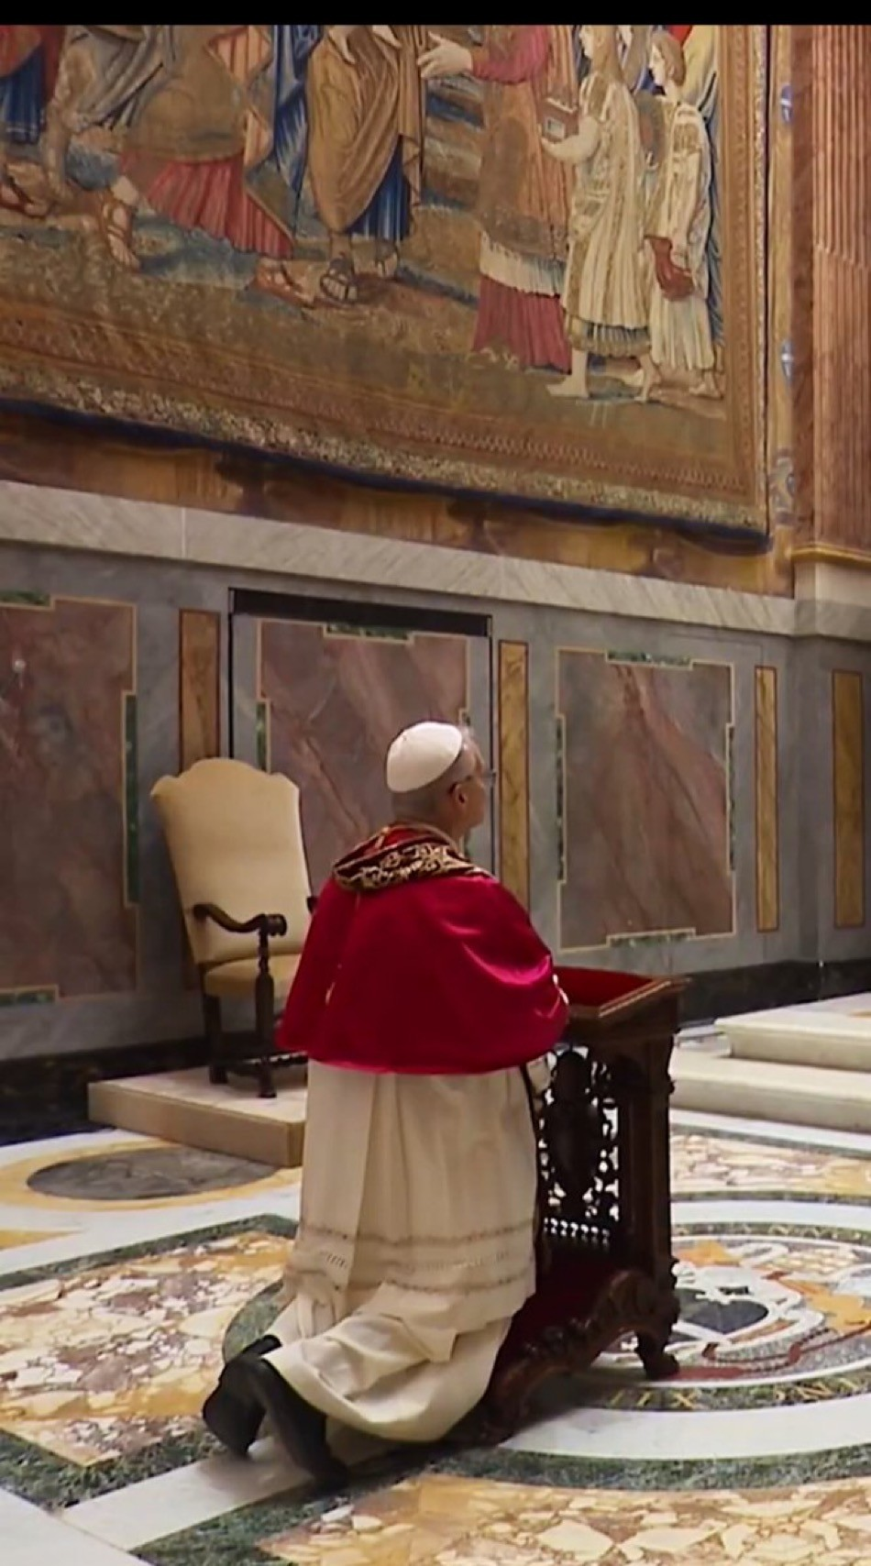
We pray that Pope Leo may lead the Church with wisdom and compassion and be a sign of God’s love and mercy for all.
Lord, in your mercy. All: Hear our prayer.
We pray that Pope Leo may have the courage to speak the message of the Gospel, bringing hope to those who need it most.
Lord, in your mercy. All: Hear our prayer.
We pray that Pope Leo may bring unity where there is division and peace where there is conflict.
Lord, in your mercy. All: Hear our prayer.

Slide 10
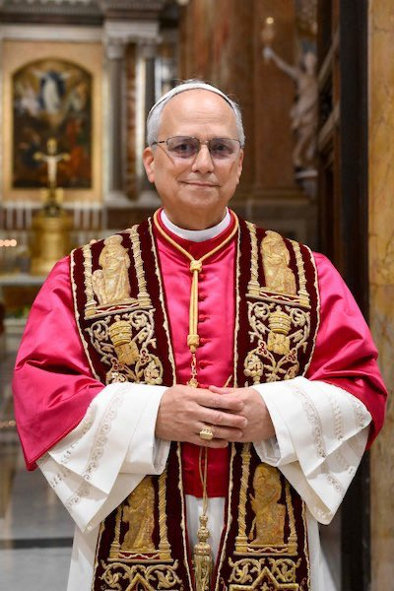
We pray together as Jesus taught us:
Our Father,
who art in heaven,
hallowed be thy name;
thy kingdom come,
thy will be done on earth as it is in heaven.
Give us this day our daily bread
and forgive us our trespasses
as we forgive those who trespass against us and lead us not into temptation
but deliver us from evil.
Amen.

Slide 11
Almighty God,
we give thanks for the gift of Pope Leo.
May he witness faithfully to the Gospel,
leading with humility and compassion
and inspiring all people to be pilgrims of hope.
We ask this through Christ our Lord.
All: Amen.

Slide 12
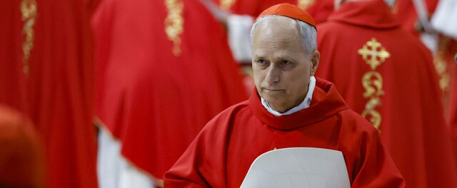
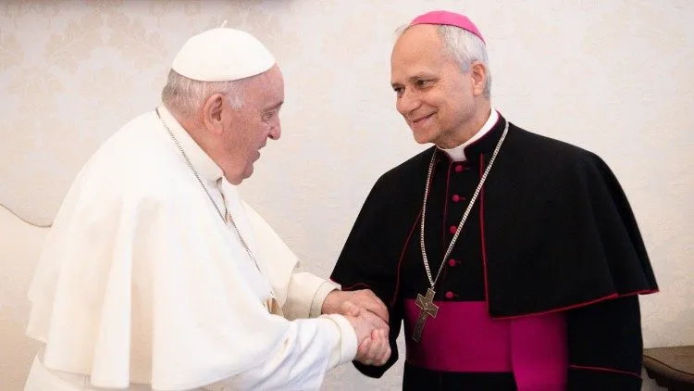
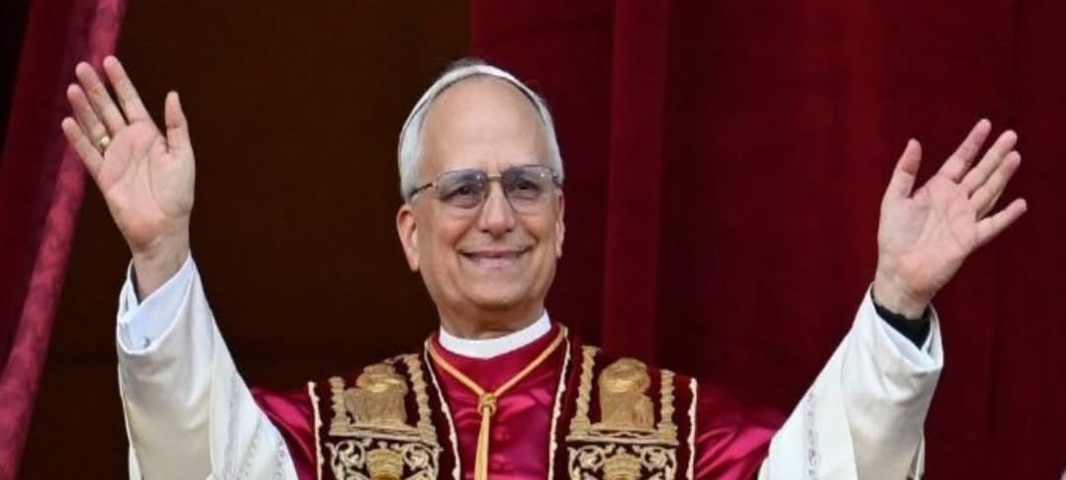
Notes:
Produced for Saint Thomas Catholic Academies Trust by Jane Porter

