Slide 1
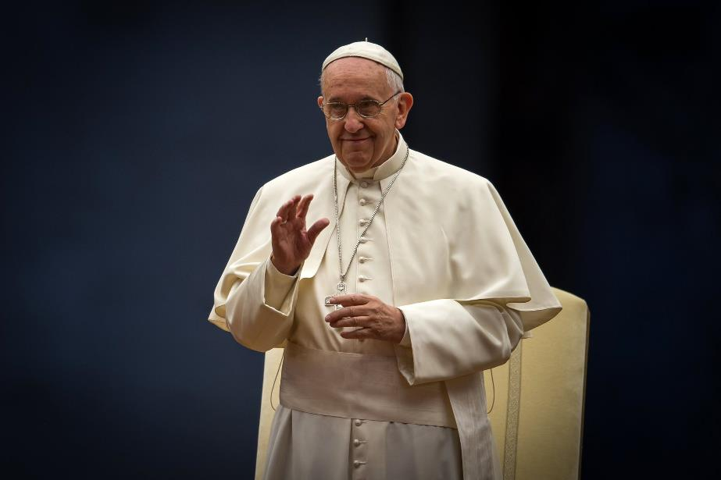
Pope Francis
17 December 1936
–
21 April 2025

Slide 2
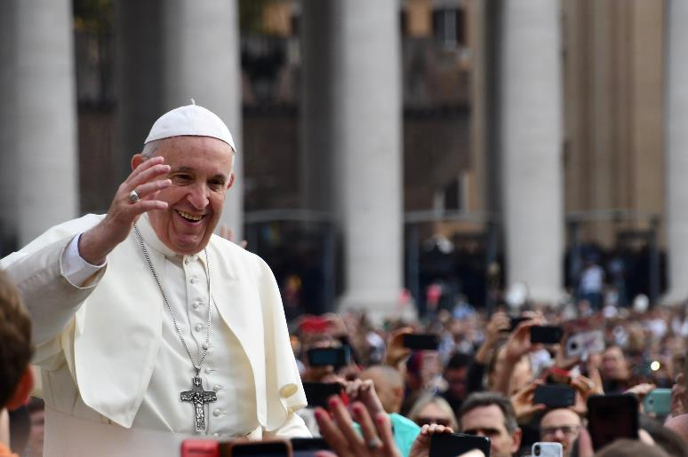
It was with great sadness that we heard that Pope Francis died yesterday morning.
Today let us pray for him.

Slide 3
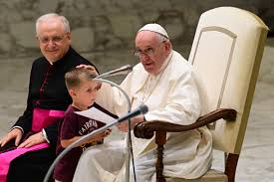
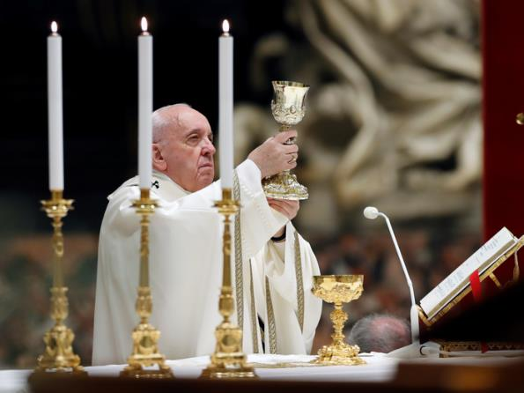
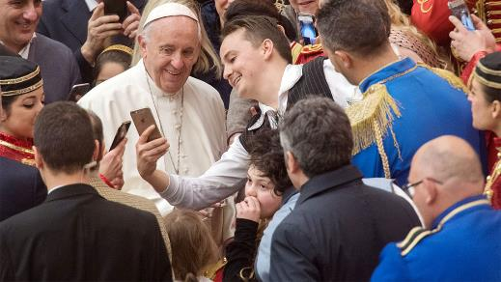
Let us give thanks for his life,
his teaching and his example.

Slide 4
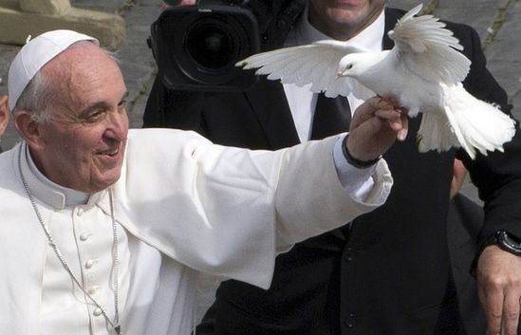
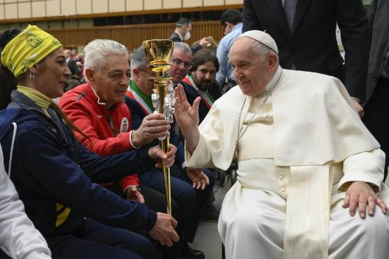
We give thanks for his commitment to work for justice and peace…

Slide 5
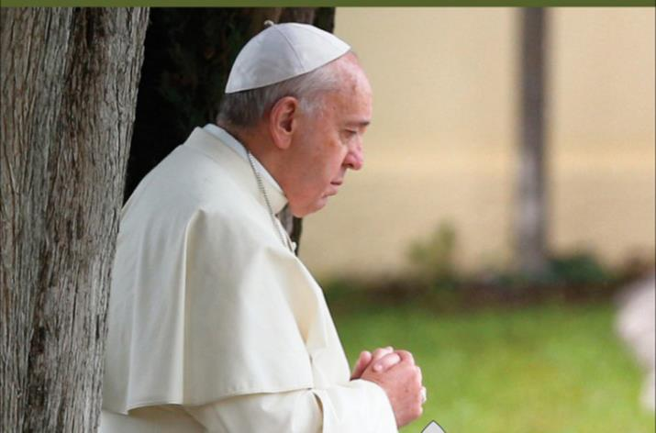
…for his care for God’s creation…
‘As stewards of God's creation, we are called to make the earth a beautiful garden for the human family. When we destroy our forests, ravage our soil and pollute our seas, we betray that noble calling.’

Slide 6
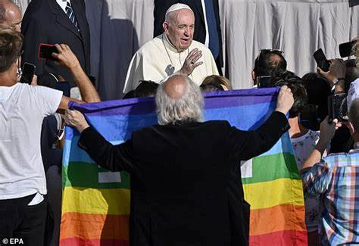
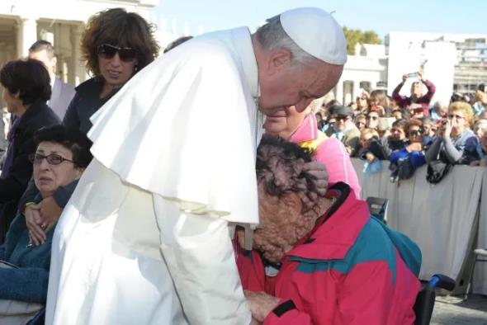
…and his compassion for all God’s people.

Slide 7
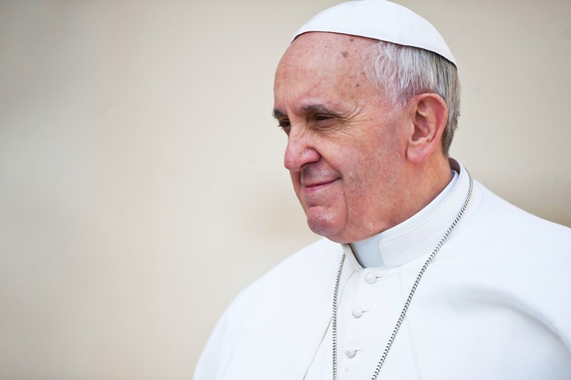
We give thanks for his encouragement to young people.
‘Dear young people, have you thought about the talents that God has given you? Have you thought of how you can put them at the service of others?
Do not bury your talents! Do not be afraid to dream of great things!’

Slide 8
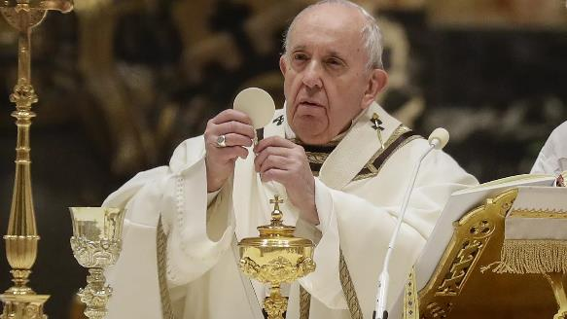
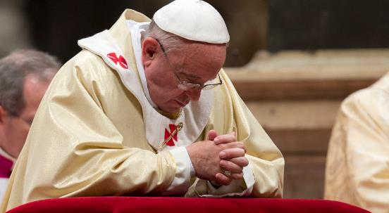
May his deep faith in Jesus Christ be a source of comfort and inspiration to us in the time ahead.

Slide 9
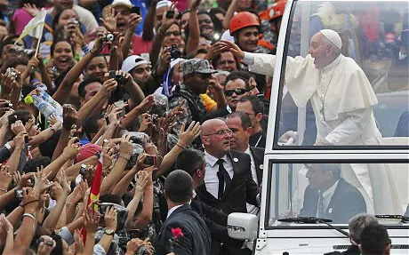
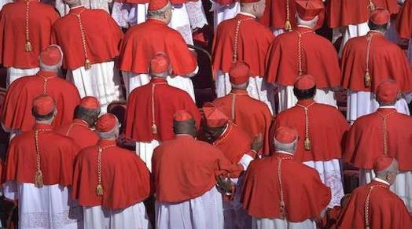
Let us pray for the Church throughout the world, as she mourns his death…
…and for those entrusted with electing his successor.

Slide 10

Jesus said,
‘I am the resurrection and the life.
Whoever believes in me, though he die,
yet shall he live,
and everyone who lives and believes in me
shall never die.’
John 11:25-26

Slide 11
Almighty God,
we thank you for the life of Pope Francis.
May we who mourn his death,
continue to live lives of faith, hope and love,
true to the teaching of the Gospel.
We pray that he may find peace in your Kingdom,
where you live for ever and ever.
All: Amen.

Slide 12
Let us pray together:
All: Eternal rest grant unto him, O Lord,
and let perpetual light shine upon him.
May he rest in peace.
Amen.

Slide 13
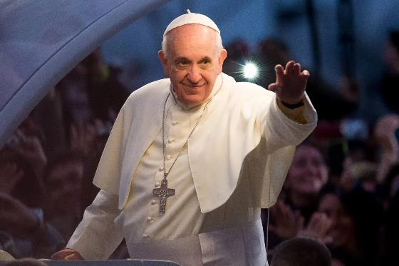
Let the risen Jesus enter your life,
welcome him as a friend,
with trust; he is life.
If up till now you have kept him
at a distance, step forward.
He will receive you with open arms.
If you have been indifferent,
take a risk;
you won’t be disappointed.
If following him seems difficult
don’t be afraid, trust him.
Be confident that
He is close to you,
He is with you
and He will give you the peace
you are looking for
and the strength to live
as he would have you do.
Pope Francis

Slide 14
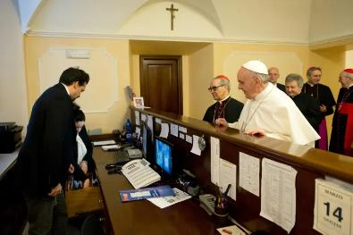
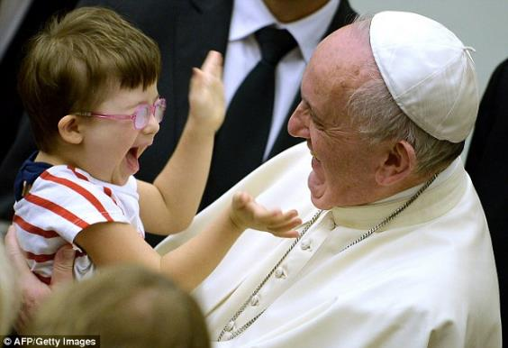
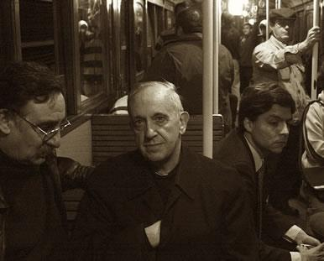
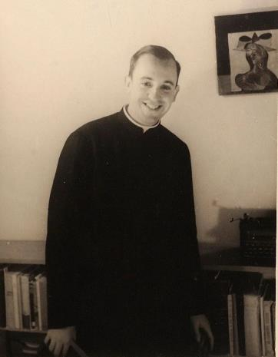
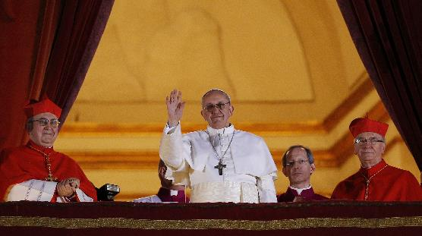
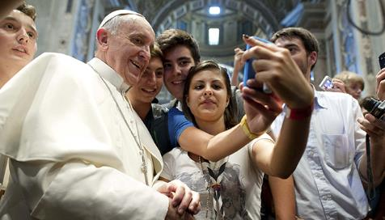
Notes:
Produced for Saint Thomas Catholic Academies Trust by Jane Porter 2025

